Slide 1
ESC101: Introduction to Computing
Overview of Programming

Slide 2
GCD
An algorithm to find the greatest common divisor of two positive integers m and n, m ≥ n.
A naïve solution – Described informally as follows.
Take the smaller number n.
For each number k, n ≥k≥1, in descending order, do the following.
If k divides m and n, then k is the gcd of m and n

Slide 3
GCD
This will compute gcd correctly, but is VERY slow (think about large numbers m and n=m-1).
There is a faster way…

Slide 4
GCD Algorithm - Intuition
To find gcd of 8 and 6.
Consider rods of length 8 and 6.
Measure the longer with the shorter.
Take the remainder if any.
Repeat the process until the longer can be exactly measured as an integer multiple of the shorter.

Slide 5
GCD Algorithm - Intuition
Remainder
8
6
2
Gcd(8, 6) = 2.

Slide 6
GCD Algorithm - Intuition
102
102 mod 21 = 18
21
21 mod 18 = 3
18
3
Gcd (102, 21) = 3

Slide 7
Euclid’s method for gcd
Suppose a > b. Then the gcd of a and b is the same as the gcd of b and the remainder of a when divided by b.
gcd(a,b) = gcd (b, a % b)
Proof:
Exercise

Slide 8
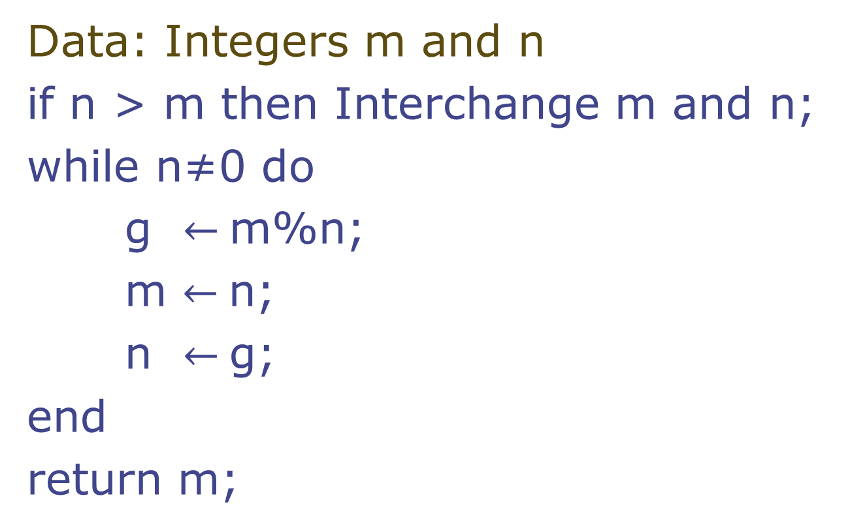
GCD Algorithm
Data: Integers m and n
if n > m then Interchange m and n;
while n≠0 do
g $←$m%n;
m $←$n;
n $←$g;
end
return m;

Slide 9
Overview of Programming
Using C

Slide 10
The Programming Cycle
Write your program or edit (i.e., change or modify) your program.
Compile your program. If compilation fails, return to editing step.
Run your program on an input. If output is not correct, return to editing step.
Repeat step 3 for other inputs, if any.
Compilation Errors ?
Write/Edit
NO
Compile
Run
YES
YES
More
Inputs
OK?
NO
YES!!
A simple development cycle of a program
Inputs
Exhausted
DONE

Slide 11
IDE for Edit-Compile-Run cycle
In this course, you will be using an Integrated Development Environment (IDE). IDE will be available through your browser.
First login to the system.
Type in your program in the editor of the IDE.
Use the compile button to compile.
Run button to run.
The labs in the first week will introduce you to the system in more detail.

Slide 12
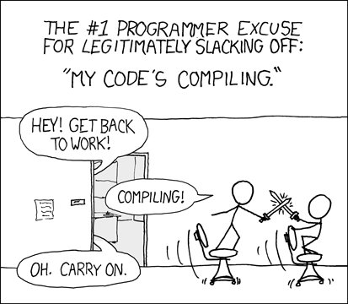
http://xkcd.com/303/

Slide 13
Why program in high level languages like C
Writing programs in machine language is long, tedious and error-prone.
They are also not portable—meaning program written for one machine may not work on another machine.
Compilers work as a bridge.
Take as input a C program and produce an equivalent machine program.
Compiler for C for a given target machine
Equivalent
Machine Program
on target machine
C program

Slide 14
Simple! Program
Today we will see some of the simplest C programs.
# include <stdio.h>
int main () {
printf(“Welcome to ESC101”);
return 0;
}
The program prints the message “Welcome to ESC101”

Slide 15
Program components
# include <stdio.h>
int main ()
{
printf(“Welcome to ESC101”);
return 0;
}
This tells the C compiler
to include the standard input
output library.
2. Include this line routinely
as the first line of your C file.
printf is the function called to output from a C program. To print a string, enclose it in “ ” and it gets printed. For now, do not try to print “ itself.
“return” returns the control to the caller (program finishes in this case.)
main() is a function.
All C programs start by executing from the first statement of the main function.
printf(“Welcome to ESC101”);
is a statement in C. Statements in C end in semicolon ;

Slide 16
printf
printf is the “voice” of the C program
Used to interact with the users
printf prints its arguments in a certain format
Format provided by user

Slide 17
Another Simple Program
Program to add two integers (17 and 23).
# include <stdio.h>
int main () {
int a = 17;
int b = 23;
int c;
c = a + b;
printf(“Result is %d”, c);
return 0;
}
The program prints the message: Result is 40

Slide 18
# include <stdio.h>
int main ()
{
int a = 17;
int b = 23;
int c;
c = a + b;
printf(“Result is %d”,c);
return 0;
}
This tells the compiler to reserve a “box” large enough to hold an integer value. The box is named “a” for use in the rest of the program.
“= 17” stores value 17 in the box that we have named “a”.
It is OK to skip this part and store value later as we do for box named “c”.
+ is an opeartor used to add two numbers. The numbers come from the values stored in the boxes named “a” and “b”
%d tells printf to expect one integer argument whose value is to be printed. We call it placeholder.
We will see more placeholders soon.

Slide 19
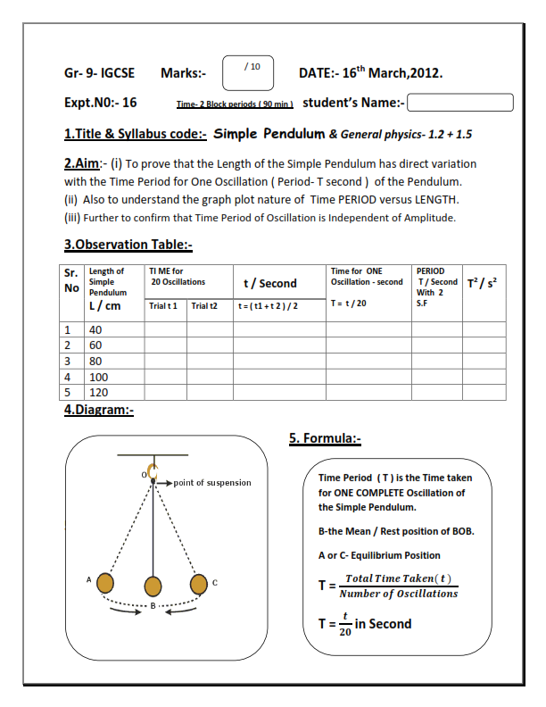
printf (% format)
% format specifiers allow C program to print things whose values are yet not computed
will be known while running the program
%... is similar to the blanks in a lab sheets used for phy/chem labs

Slide 20
Another Simple Program
A smaller program to add two integers (17 and 23).
# include <stdio.h>
int main () {
printf(“Result is %d”, 17+23);
return 0;
}
The program prints the message “Result is 40”
In this case + is operating directly on two integer constants.

Slide 21
Types
Type:
A set of values
A set of operations on these values
We have been using types
Natural numbers
1, 2, 3, … values
+, - , *, >, <, … operations
Complex numbers
5 + 3i, 7 + 2i, …
+, - , *, /, conjugate, …
NO >, < operations

Slide 22
Data Types in C
int
Bounded integers, e.g. 732 or -5
float
Real numbers, e.g. 3.14 or 2.0
double
Real numbers with more precision
char
Single character, e.g. a or C or 6 or $

Slide 23
Notes on Types: char
Characters are written with ‘ ’ (quotes)
‘a’, ‘A’, ‘6’, ‘$’
Case sensitive
‘a’ is not same as ‘A’
Types distinguish similar looking values
Integer 6 is not same as character ‘6’
Special characters:
\n (newline), \’ (quote), \” (double quote), \\ (backslash itself), … and many more
NOTE: these are SINGLE CHARACTERS, and have to be enclosed in quotes, as ‘\n’

Slide 24
More Notes on Types
Integers (int) are bounded
Max value: INT_MAX
Min value: INT_MIN
These values are system specific
-2147483648 … 2147483647 on my machine
Other data types can only store finite number of values
Even some simple real values can not be represented by float and double
Can surprise you sometime

Slide 25
#include <limits.h>
#include <stdio.h>
int main() {
printf("Min=%d, Max=%d",
INT_MIN, INT_MAX);
return 0;
}
OUTPUT:
Min=-2147483648, Max=2147483647
limits.h contains the definitions of INT_MAX and INT_MIN
1. A statement can span multiple lines.
2. printf can use multiple % placeholders.

Slide 26

#include <stdio.h>
int main() {
float y = 100000009.0;
printf("Value of y is %f", y);
return 0;
}
%f is the placeholder for float.
OUTPUT:
Value of y is 100000008.0

Slide 27

Function main
The point at which C program begins its execution
Every complete C program must have exactly one main
int main () { … }
Returns an int to its caller (Operating System)
Return value is generally used to distinguish successful execution (0) from an unsuccessful execution (non 0)

Slide 28
Function main
Arguments: none ()
At least for now
Body: C statements enclosed inside { and } (to solve the problem in hand)

Slide 29
Tracing the Execution
Line No.
# include <stdio.h>
int main()
{
printf(“Welcome to “);
printf(“C Programming”);
return 0;
}
Program counter starts at the first executable statement of main.
Line numbers of C program are given for clarity.
Let us run the program, one step at a time.
Program terminates gracefully when main ``returns’’.
1
2
3
4
5
6
Output:
After lines 3,4
After lines 5,6
Welcome to
C Programming

Slide 30
Variables
A name associated with memory cells (box-es) that store data
Type of variable determines the size of the box.
int m = 64;
char c = ‘X’;
float f = 3.1416;
Variables can change their value during program
f = 2.7183;
64
X
3.1416
2.7183
3.1416

Slide 31

Variable: Box and Value
Another analogy is that of Envelope and Letter
Envelope must be big enough to hold the letter!

Slide 32
Variable Declaration
To communicate to compiler the names and types of the variables used by the program
Type tells size of the box to store value
Variable must be declared before used
Optionally, declaration can be combined with definition (initialization)
int count;
int min = 5;
Declaration without initialization
Declaration with initialization

Slide 33
Identifiers
Names given to different objects
Variable, Function etc.
Consists of letters, digits and underscore (_) symbol
Must start with a letter or _
i, count, Lab5, max_Profit, _left, fUnNy
5j, min Profit, lab.7

Slide 34
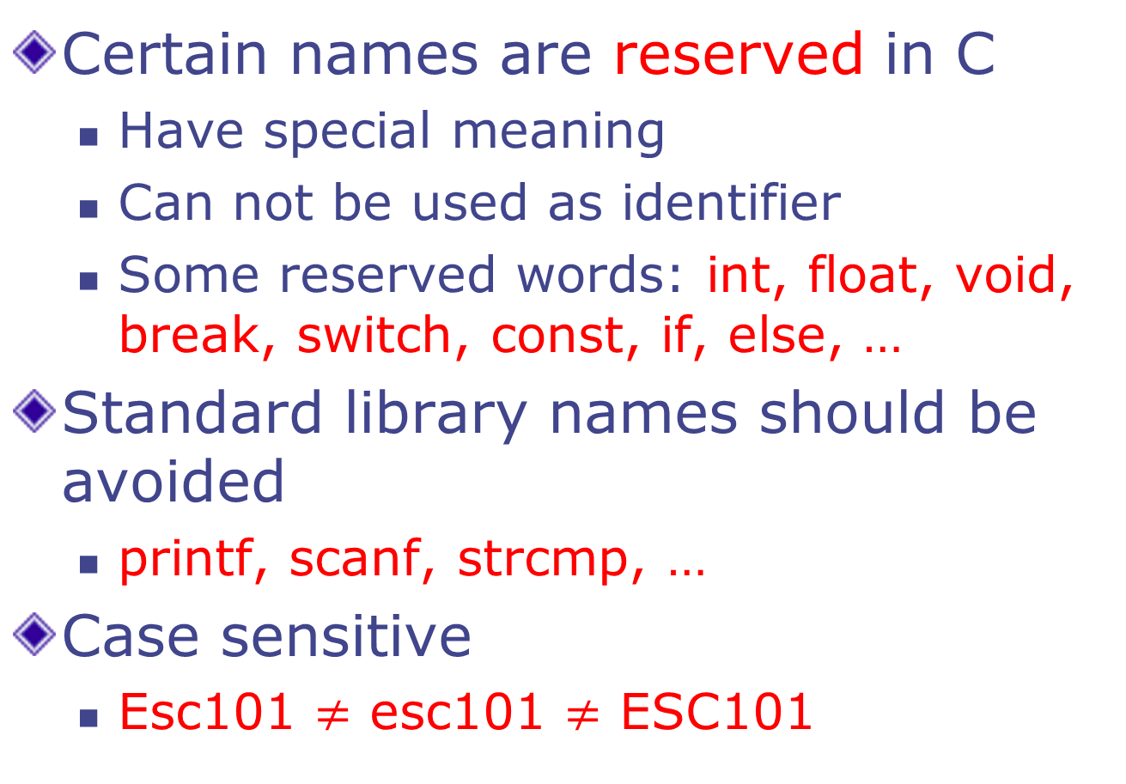
Identifiers
Certain names are reserved in C
Have special meaning
Can not be used as identifier
Some reserved words: int, float, void, break, switch, const, if, else, …
Standard library names should be avoided
printf, scanf, strcmp, …
Case sensitive
Esc101 $≠$ esc101 $≠$ ESC101

Slide 35
Choosing Identifiers
“What's in a name? that which we call a rose By any other name would smell as sweet.”
Choose meaningful names
count vs c vs tmp1
Should be easy to read and understand
count vs c_o_u_n_t
Shorten only when no loss of meaning
Max vs Maximum
Avoid unnecessary long names
a_loop_counter vs counter vs i

Slide 36
Assignment Statement
A simple assignment statement
Variable = Expression;
Computes the value of the expression on the right hand side expression (RHS), and stores it in the “box” of left hand side (LHS) variable
= is known as the assignment operator.

Slide 37
Assignment Statement
Examples
x = 10;
ch = ‘c’;
disc_2 = b*b – 4*a*c;
count = count + 1;
Evaluation of an assignment stmt:
Expression on the RHS of the = operator is first evaluated.
Value of the expression is assigned to the variable on the LHS.
If count was 5 before the assignment, it will become 6 after the assignment.

Slide 38
Input/Output
Input: receive data from external sources (keyboard, mouse, sensors)
Output: produce data (results of computations) (to monitor, printer, projector, …)

Slide 39
Input/Output
printf function is used to display results to the user. (output)
scanf function is used to read data from the user. (input)
Both of these are provided as library functions.
#include <stdio.h> tells compiler that these (and some other) functions may be used by the programmer.

Slide 40
printf
list of expressions (separated by comma)
string to be displayed, with placeholders
\n is the newline character.
printf("%d kms is equal\nto %f miles.\n", km, mi);
The string contains placeholders (%d and %f). Exactly one for each expression in the list of expressions.
Placeholder and the corresponding expr must have compatible type.
While displaying the string, the placeholders are replaced with the value of the corresponding expression: first placeholder by value of first expression, second placeholder by value of second expression, and so on.

Slide 41
Using format string in printf
printf(“a= %d, b= %d, hypotenuse squared =%d”, a,b, csquare);
format string
marker
Argument
marker
1. format marker marks the first character of the format string.
2. Argument marker marks the first argument after the format string.
3. Print the character marked by format marker and advance format marker one character at a time until a %d is met or the format string finishes.
4. If format string finishes, we TERMINATE.
5. If control string marker reads %d, then printf takes the value of the variable at the argument marker and prints it as a decimal integer.
6. Advance argument marker; advance format marker past %d.
Go to step 3.
a=
3
, b=
4
, hypotenuse squared =
25

Slide 42
scanf
& is the addressof operator.
To Be Covered Later.
Similar to printf: string with placeholders, followed by list of variables to read
scanf("%d", &km);
Note the & before the variable name. DO NOT FORGET IT.
String in " " contains only the placeholders corresponding to the list of variables after it.
Best to use one scanf statement at a time to input value into one variable.

Slide 43
Some Placeholders
Placeholder | Type
%d | int
%f | float
%lf | double
%c | char
%% | literal percent sign (%)
If placeholder and expression/variable type do
not match, you may get unexpected results.

Slide 44
Formatting Output of a Program (int)
When displaying an int value, place a number between the % and d which will specify the number of columns to use for displaying the int value (such as %5d).
Output
2345
2345
123
2345
int x = 2345, y=123;
printf("%d\n",x); //Usual
printf("%6d\n",x); //Display using 6 columns
printf("%6d\n",y); //Note: Right aligned
printf("%2d\n",x); //Less columns, same as %d

Slide 45
Formatting Output of a Program (float)
Format placeholder id is %n.mf where
n is the total field width (both before and after the decimal point), and
m is the number of digits to be displayed after the decimal
point.
Output
3.141592
3.14
3.1416
float pi = 3.141592;
printf("%f\n",pi); //Usual
printf("%6.2f\n", pi); //2 decimal
printf("%.4f\n",pi); //4 decimal
// Note rounding off!

Slide 46

Good and Not so good printf’s
# include <stdio.h>
int main() {
float x;
x=5.67123;
printf(“%f”, x);
return 0;
}
Output
Compiles ok
5.671230
# include <stdio.h>
int main() {
float x;
x=5.67123;
printf(“%d”, x);
return 0;
}
Compiles ok
-14227741
Printing a float using %d option is undefined. Result is machine dependent and can be unexpected. AVOID!
C often does not give compilation errors even when operations are undefined. But output may be unexpected!

Slide 47
Comments
Supplementary information in programs to make understanding easier
Only for Humans!
Ignored by compilers

Slide 48
Comments in C
Anything written between /* and */ is considered a comment.
diameter = 2*radius; /* diameter of a circle */
Comments can NOT be nested.
/* I am /* a comment */ but I am not */
First */ ends the effect of all unmatched start-of-comments (/*).

Slide 49
Comments in C
Anything written after // up to the end of that line
diameter = 2*radius; // diameter of a circle
area = pi*radius*radius; // and its area
Not all C compilers support this style of comments.
Our lab compiler does support it.

Slide 50
Summary: An Example Program
#include <stdio.h>
int main()
{
float mi, km; // decl without initialization
scanf("%f",&mi); // get miles from user
km = mi * 1.609; // compute and store km
printf(“%.3f miles = %.3f kms.\n”,
mi, km); // show the answer.
return 0;
}

